Slide 1
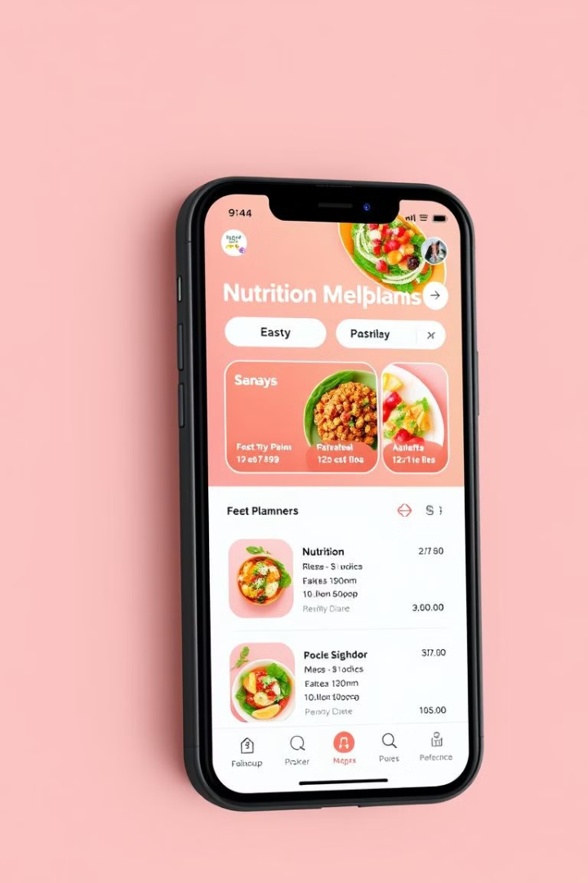
Nutri Connect :
Simplifying Health and Wellness Through Technology
Team Members:
PABBU SAKETH {S20230010169} {saketh.p23@iiits.in}
NERELLA VENKATA SRI RAM {S20230010164}{venkatasriram.n23@iiits.in}
INALA SYAMA SRI SAI{S20230010104}{syamasrisai.i23@iiits.in}
NULAKAJODU MAANAS ANAND {S20230010166}{maanasanand.n23@iiits.in}
NITTA PRADEEP{S20230010165}{pradeep.n23@iiits.in}

Slide 2
Introduction to the Project
This project aims to develop a comprehensive nutrition planner website that empowers users to take control of their health and wellness.
By providing an intuitive and engaging platform, we empower users to create personalized meal plans, track their nutrient intake, and set achievable health goals.

Slide 3

The Need for a Nutri Connect
1
Rising Health Concerns
2
Increased Awareness
3
Technological Advancements
The prevalence of chronic diseases like obesity, heart disease, and diabetes is increasing globally.
People are increasingly aware of the link between diet and overall health, seeking personalized guidance.
The demand for user-friendly digital tools to manage health is growing rapidly, as people embrace technology.

Slide 4




Key Features: Meal Planning, Nutrient Tracking, and Goal Setting
Meal Planning
Nutrient Tracking
Goal Setting
Users can create custom meal plans tailored to their dietary needs, preferences, and goals.
The website allows users to track their nutrient intake, ensuring they meet their daily requirements.
Users can set specific health goals, such as weight loss, muscle gain, or improving overall nutrition.

Slide 5

Intuitive User Interface Design
Easy Navigation
Visual Appeal
Personalized Experience
The website features a clear and intuitive layout, making it easy for users to find what they need.
The user interface is visually appealing, incorporating engaging graphics and a modern design.
The website is designed to personalize the user experience based on their unique needs and preferences.

Slide 6
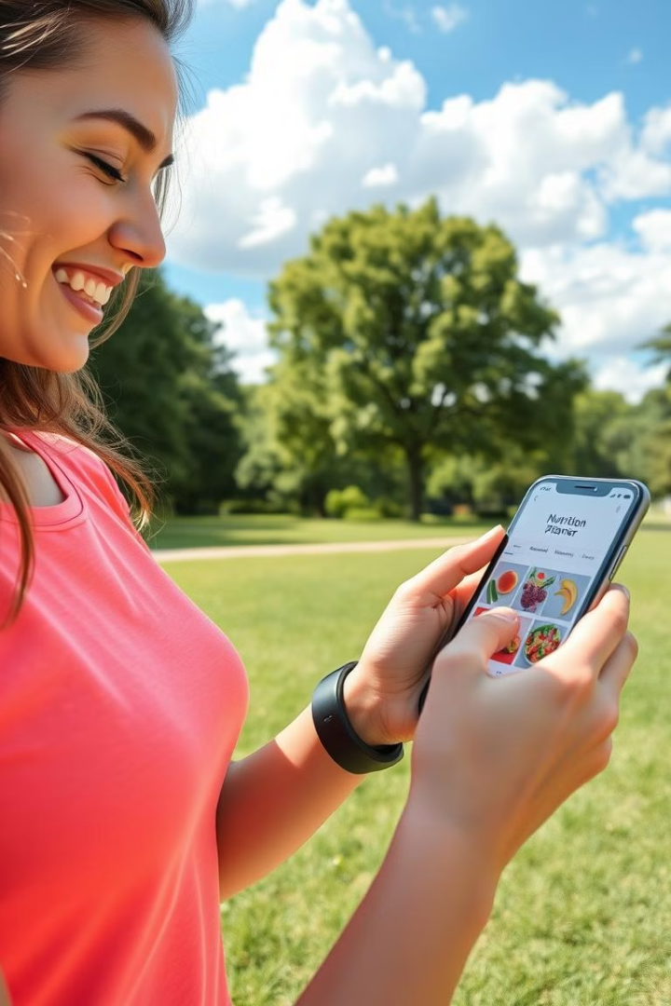
Integrating Fitness and Wellness Data
1
Integrate with popular fitness trackers to provide a comprehensive view of overall health.
2
Track activity levels, sleep patterns, and other relevant fitness data for a holistic understanding of well-being.
3
Use integrated data to create more personalized recommendations and optimize meal plans for fitness goals.

Slide 7




Connecting Users with Nutritionists and Dietitians
Provide users with the option to connect with qualified nutritionists and dietitians for personalized consultations.
Offer a platform for users to receive professional guidance and tailored dietary advice from experts.
Facilitate communication and collaboration between users and professionals for optimal health outcomes.

Slide 8



Scalability and Future Expansion Plans
1
Mobile App Development
Expanded Healthy Recipies Database
2
Integrate a comprehensive recipe database with healthy and delicious options.
Community Features
3
Enable users to connect with other user and support in nutrition plans , and support each other on their health journeys.

